Slide 1
Unit-4
Dynamic Programming

Slide 2
Strategy for designing algorithms is dynamic programming
Used when problem breaks down into recurring small sub problems
Dynamic programming is typically applied to optimization problems. In such problem there can be many solutions.
Each solution has a value and have to find a solution with the optimal value.

Slide 3
Divide-and-Conquer
Divide and conquer method for algorithm design:
Divide: If the input size is too large than divide the problem into two or more disjoint subproblems.
Conquer: Conquer recursively to solve the subproblems.
Combine: Take the solutions to the subproblems and merge these solution for the original problem.
Example: Merge-sort

Slide 4
Difference between Divide-and-Conquer and Dynamic Programming:
Both splits their input into parts, find subproblems to the parts and synthesize larger solutions from smaller ones.
Divide-and-Conquer | Dynamic Programming
Split its input at prespecified deterministic point (e.g. always in middle) | Split its input at every possible split point rather than at a prespecified point. After trying all split points, it determines optimal path.
The problem have independent subproblems | The subproblems are not independent

Slide 5
Dynamic Programming
Dynamic programming: Find out all possible solutions and than pickup the best solution/ optimal solution.
Used for solving optimization problem.
Idea of dynamic programming: avoid calculating the same thing twice, usually by keeping a table of known result that fills up a sub instances are solved. For any problem there may be many solution which are feasible, so find solutions of all problem and than choose optimal solution.
Divide and conquer is a top-down method.
Dynamic programming like divide-and-conquer method solve problems by combining the solutions to sub-problems.

Slide 6
On the other hand Dynamic programming is a bottom-up technique.
We usually start with the smallest and the simplest sub- instances.
By combining their solutions, we obtain the answers to sub-instances of increasing size until finally we arrive at the solution of the original instances.
Dynamic programming always give optimal answer.
Dynamic programming adopt tabulation method and memoization method.

Slide 7
Principle of Optimality
Dynamic programming obtain the solution using principle of optimality.
A problem can be solved by taking sequence of decisions to get the optimal solution.
In a optimal sequence of decisions or choices, each subsequence must also be optimal.
When it is not possible to apply the principle of optimality it is almost impossible to obtain the solution using the dynamic programming approach.

Slide 8
Example: Finding of shortest path in a given graph uses the principle of optimality.
Suppose that in solving a problem, we have to make a sequence od decisions D1, D2, ...., Dn. If this sequence is optimal then the last k decisions, 1<k<n must be optimal.
If i, i1, i2, ..., j is a shortest path from i to j, then i1, i2, ... , must be a shortest path from i1 to j.

Slide 9
Elements of Dynamic Programming
Dynamic programming is used to solve problems with the following characteristics:
Optimal Substructure:
The optimal solution to the problem contains within optimal solution to its subproblems.
Problem is divide into subproblems than subproblems are solved individually and than combine all the subproblems to get final answer.
Overlapping Subproblems:
there exist some places where we solve the same sub problem more than once.
In case of dynamic programming, subproblems are repeated. If we store the data in table so, whenever the same subproblems get occur we simply put the data of that subproblems from the table.

Slide 10
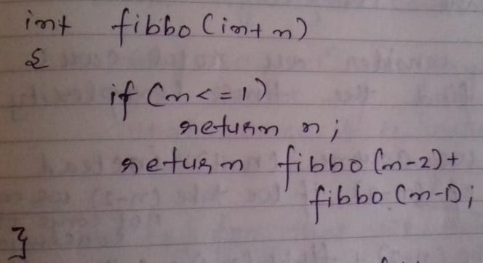
Memoization Method:
By storing the results of function, we avoiding the same call again and again. To avoid the same call again and again by storing the result in an array.
Compute solution in a bottom-up fashion

Slide 11
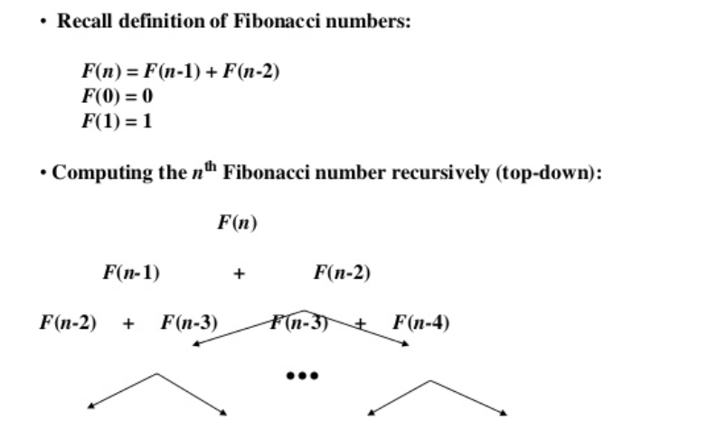
Example: Fibonacci numbers

Slide 12
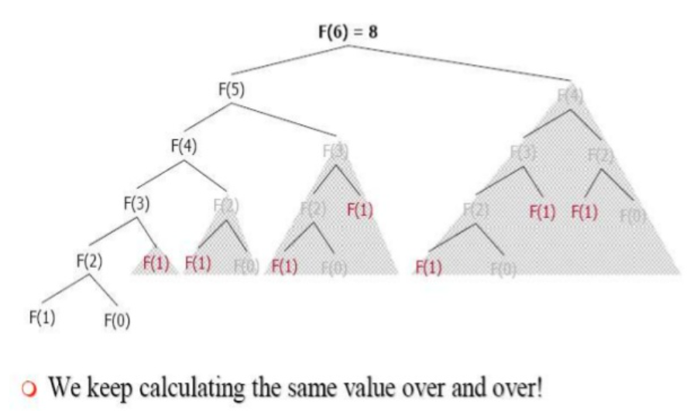

Slide 13
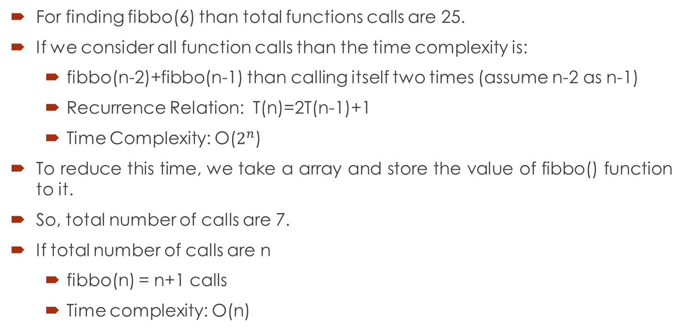
For finding fibbo(6) than total functions calls are 25.
If we consider all function calls than the time complexity is:
fibbo(n-2)+fibbo(n-1) than calling itself two times (assume n-2 as n-1)
Recurrence Relation: T(n)=2T(n-1)+1
Time Complexity: O($2^{n}$)
To reduce this time, we take a array and store the value of fibbo() function to it.
So, total number of calls are 7.
If total number of calls are n
fibbo(n) = n+1 calls
Time complexity: O(n)

Slide 14
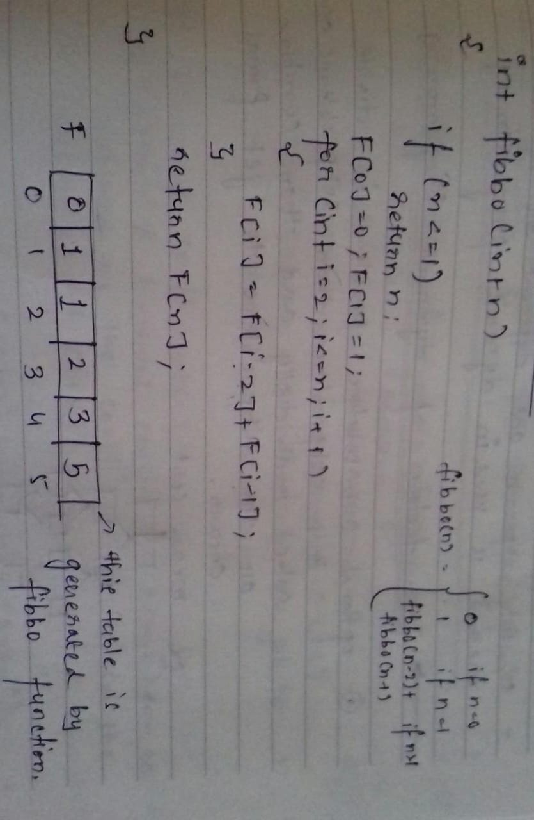
Tabulation Method

Slide 15
We mostly write iterative functions only in dynamic programming which will fill up the table to get the values from the smaller value onwards.
It is bottom-up approach.
Mostly tabulation method is used in dynamic programming.

Slide 16

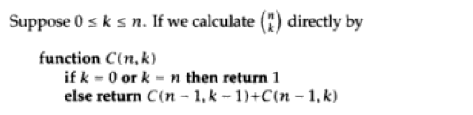

Binomial Coefficients
A binomial coefficient C(n,k) can be defined as the coefficient of $x^{k}$in the expansion of ${(1+x)}^{n}$.

Slide 17
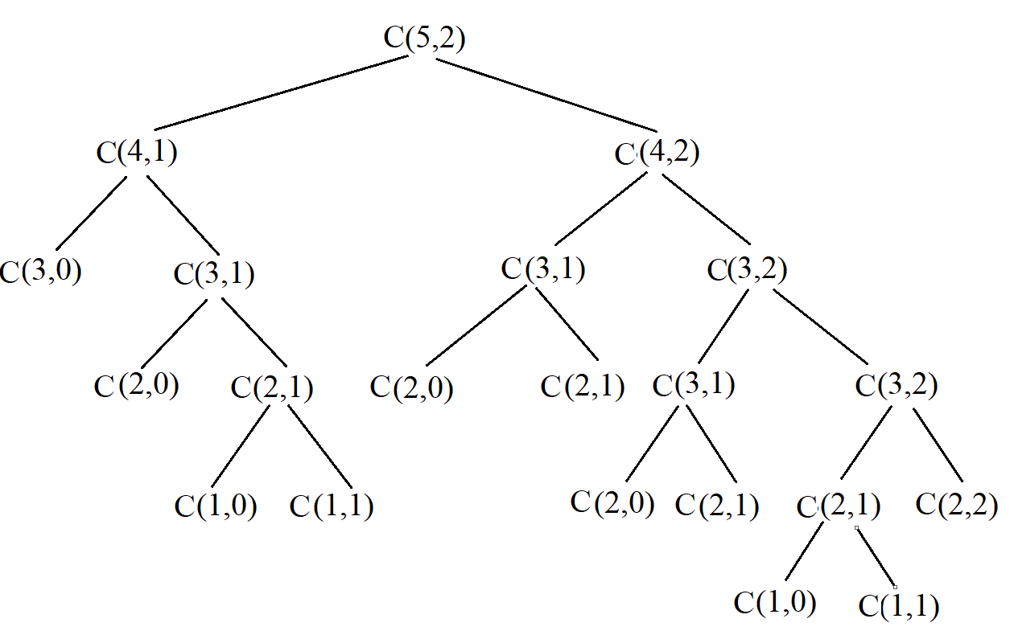

Slide 18
Application of Dynamic Programming
0/1 Knapsack problem
All pair shortest path problem
Matric chain multiplication
Longest Common Subsequence (LCS)

Slide 19
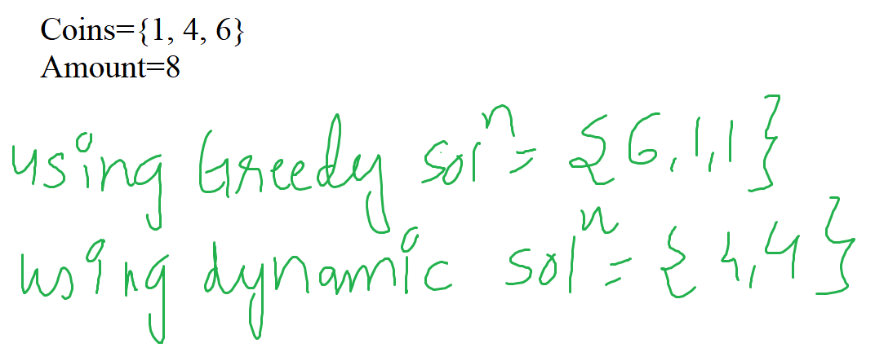
Making Change problem:
Given: Coins of different denomination and amount
Problem: Find out minimum number of coins to make change of given amount using given coins [infinite supply of coins].
Greedy algorithm works only in a limited number of instances or when a coins of a particular denomination are missing or in short supply, the algorithm may either find a suboptimal answer or not find an answer at all.

Slide 20
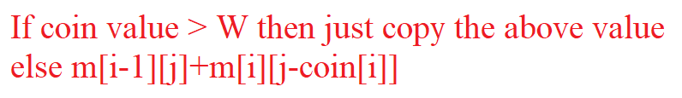
Steps:
Exclude the coin
Include the coin
Add (1) and (2)
Example:
Coins: {2, 3, 5, 10}
W: 15 (Total Amount)
Find total possible ways?

Slide 21
 | 0 | 1 | 2 | 3 | 4 | 5 | 6 | 7 | 8 | 9 | 10 | 11 | 12 | 13 | 14 | 15
2 | 1 | 0 | 1 | 0 | 1 | 0 | 1 | 0 | 1 | 0 | 1 | 0 | 1 | 0 | 1 | 0
3 | 1 | 0 | 1 | 1 | 1 | 1 | 2 | 1 | 2 | 2 | 2 | 2 | 3 | 2 | 3 | 3
5 | 1 | 0 | 1 | 1 | 1 | 2 | 2 | 2 | 3 | 3 | 4 | 4 | 5 | 5 | 6 | 7
10 | 1 | 0 | 1 | 1 | 1 | 2 | 2 | 2 | 3 | 3 | 5 | 4 | 6 | 6 | 7 | 9
W(j)
Coins (i)
9
Total Possible ways

Slide 22
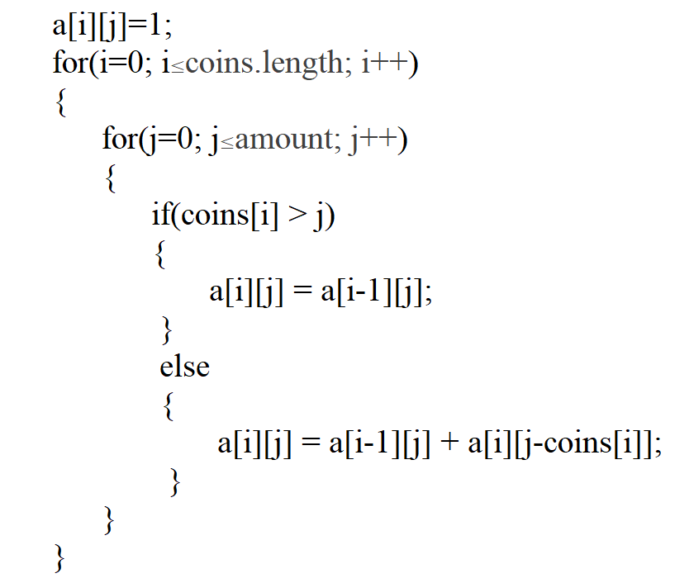
Algorithm:

Slide 23
Example:
Coins: {1, 5, 6, 9} (Use infinite number of coins)
Amount W = 10
Find minimum number of coins?
We use tabular method/bottom-up approach

Slide 24
 | 0 | 1 | 2 | 3 | 4 | 5 | 6 | 7 | 8 | 9 | 10
1 | 0 | 1 | 2 | 3 | 4 | 5 | 6 | 7 | 8 | 9 | 10
5 | 0 | 1 | 2 | 3 | 4 | 1 | 2 | 3 | 4 | 5 | 2
6 | 0 | 1 | 2 | 3 | 4 | 1 | 1 | 2 | 3 | 4 | 2
9 | 0 | 1 | 2 | 3 | 4 | 1 | 1 | 2 | 3 | 1 | 2
W(j)
Coins (i)
2
Minimum no. of coins

Slide 25
 | 0 | 1 | 2 | 3 | 4 | 5 | 6 | 7 | 8 | 9 | 10
1 | 0 | 1 | 2 | 3 | 4 | 5 | 6 | 7 | 8 | 9 | 10
5 | 0 | 1 | 2 | 3 | 4 | 1 | 2 | 3 | 4 | 5 | 2
6 | 0 | 1 | 2 | 3 | 4 | 1 | 1 | 2 | 3 | 4 | 2
9 | 0 | 1 | 2 | 3 | 4 | 1 | 1 | 2 | 3 | 1 | 2
W(j)
Coins (i)
Different
Same
Same
2
When we finally reach 0. i.e. initial state than further no coins are selected. So, 2 coins of 5rs. Is selected which is optimal solution.

Slide 26
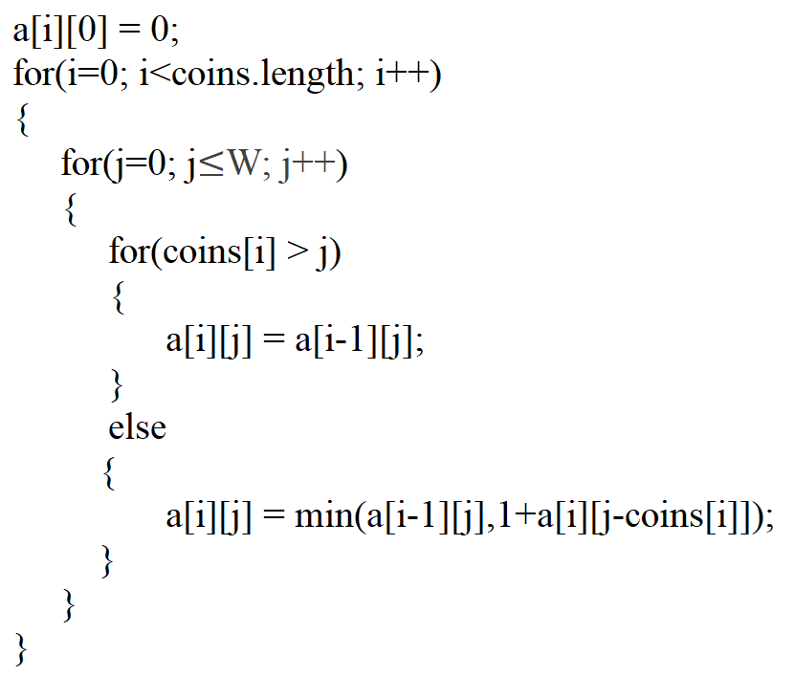
Time Complexity: O(n * w)
Where n=no. of coins and w=amount

Slide 27
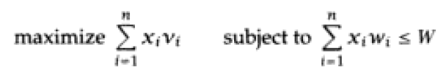
0/1 Knapsack Problem
This problem is similar to ordinary knapsack problem but we may not take a fraction of an object.
We are given ‘ N ‘ object with weight Wi and profits Pi where i varies from 1 to N and also a knapsack with capacity ‘ M ‘.
The problem is, we have to fill the bag with the help of ‘ N ‘ objects and the resulting profit has to be maximum.
Formally, the problem can be started as,

Slide 28
Where Xi are constraints on the solution Xi  {0,1}. Xi is required to be 0 or 1. if the object is selected then the unit in 1. if the object is rejected than the unit is 0. So, that why it is called as 0/1 knapsack problem.
0 = Object is absent
1 = Object is present
You have to pick the item completely means it is not divisible. Either you have to select that object or not selected. You can’t use fraction of that object.

Slide 29
Rules to fill the table:
If i=1 and j < w(i) then T(i,j) =0 filled in the table.
If i=1 and j ≥ w (i) then T (i,j) = p(i), the cell is filled with the profit p[i], since only one object can be selected to the maximum.
If i>1 and j < w(i) then T(i,1) = T (i-1,j) the cell is filled the profit of previous object since it is not possible with the current object.
If i>1 and j ≥ w(i) then T (i,j) = {f(i) +T(i-1,j-w(i)),. since only ‘1’ unit can be selected to the maximum. If is the current profit + profit of the previous object to fill the remaining capacity of the bag.

Slide 30
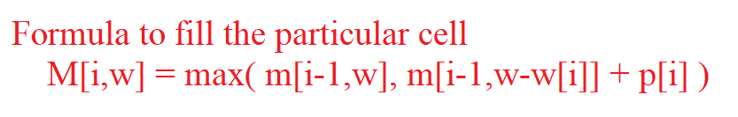
Example:
Weight: {3, 4, 6, 5}
Profit: {2, 3, 1, 4}
W = 8

Slide 31
 |  |  | 0 | 1 | 2 | 3 | 4 | 5 | 6 | 7 | 8
Pi | Wi | 0 | 0 | 0 | 0 | 0 | 0 | 0 | 0 | 0 | 0
2 | 3 | 1 | 0 | 0 | 0 | 2 | 2 | 2 | 2 | 2 | 2
3 | 4 | 2 | 0 | 0 | 0 | 2 | 3 | 3 | 3 | 5 | 5
4 | 5 | 3 | 0 | 0 | 0 | 2 | 3 | 4 | 4 | 5 | 6
1 | 6 | 4 | 0 | 0 | 0 | 2 | 3 | 4 | 4 | 5 | 6
i
W
6
Maximum Profit

Slide 32
 |  |  | 0 | 1 | 2 | 3 | 4 | 5 | 6 | 7 | 8
Pi | Wi | 0 | 0 | 0 | 0 | 0 | 0 | 0 | 0 | 0 | 0
2 | 3 | 1 | 0 | 0 | 0 | 2 | 2 | 2 | 2 | 2 | 2
3 | 4 | 2 | 0 | 0 | 0 | 2 | 3 | 3 | 3 | 5 | 5
4 | 5 | 3 | 0 | 0 | 0 | 2 | 3 | 4 | 4 | 5 | 6
1 | 6 | 4 | 0 | 0 | 0 | 2 | 3 | 4 | 4 | 5 | 6
i
W
Different
Same
Different
Same
Profit => 6-4 = 2 So, Selected Objects = {1, 0, 0, 1}
2-2 = 0

Slide 33
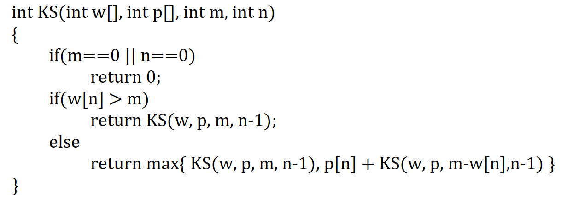
Algorithm:
Time complexity = O(n * m)

Slide 34
when i=1
when i=2
T(i,w) = max {T[i-1,w], m[i-1,w-w[i]] + p[i]}
T(1,3) = max {T(2+0),0} = 2
T(1,4) = max {T(2+0),0} = 2
T(1,5) = max {T(2+0),0} = 2
T(1,6) = max {T(2+0),0} = 2
T(1,7) = max {T(2+0),0} = 2
T(1,8) = max {T(2+0),0} = 2
T(i,w) = max {T[i-1,w], m[i-1,w-w[i]] + p[i]}
T(2,4) = max {T(3+0),2} = 3
T(2,5) = max {T(3+0),2} = 3
T(2,6) = max {T(3+0),2} = 3
T(2,7) = max {T(3+2),2} = 5
T(2,8) = max {T(3+2),2} = 5

Slide 35
when i=3
when i=4
T(i,w) = max {T[i-1,w], m[i-1,w-w[i]] + p[i]}
T(3,5) = max {T(4+0),3} = 4
T(3,6) = max {T(4+0),3} = 4
T(3,7) = max {T(4+0),5} = 5
T(3,8) = max {T(4+2),5} = 6
T(i,w) = max {T[i-1,w], m[i-1,w-w[i]] + p[i]}
T(4,6) = max {T(1+0),4} = 4
T(4,7) = max {T(1+0),5} = 5
T(4,8) = max {T(1+0),6} = 6

Slide 36
Floyd’s Algorithm for shortest path
Floyd-Warshall Algorithm is an algorithm for finding the shortest path between all the pairs of vertices in a weighted graph. As a result of this algorithm, it will generate a matrix which will represent the minimum distance from any node to all other nodes in the graph.
This algorithm works for both the directed and undirected weighted graphs. But, it does not work for the graphs with negative cycles (where the sum of the edges in a cycle is negative).
Floyd-Warshall algorithm is also called as Floyd's algorithm, Roy-Floyd algorithm, Roy-Warshall algorithm and WFI algorithm.

Slide 37
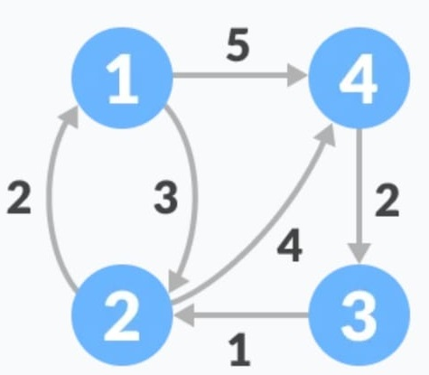
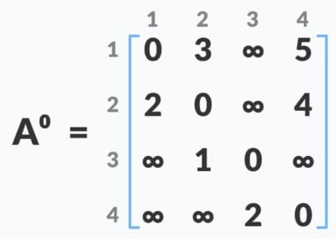
How Floyd’s warshall algorithm works?
Create a matrix A⁰ of dimension n*n where n is the number of vertices. The row and the column are indexed as i and j respectively. i and j are the vertices of the graph.
Each cell A[i][j] is filled with the distance from the i^{th} vertex to the j^{th} vertex. If there is no path from i^{th} vertex to j^{th} vertex, the cell is left as infinity.

Slide 38
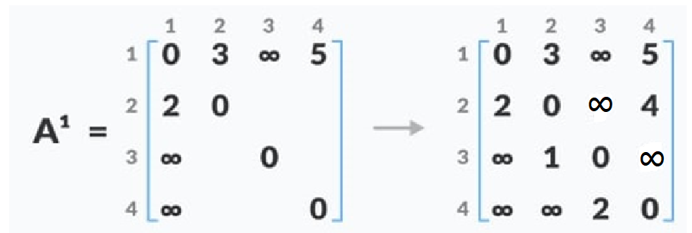
Now, create a matrix A¹ using matrix A⁰. The elements in the first column and the first row are left as they are. The remaining cells are filled in the following way.
Let k be the intermediate vertex in the shortest path from source to destination. In this step, k is the first vertex. A[i][j] is filled with (A[i][k] + A[k][j]) if (A[i][j] > A[i][k] + A[k][j]

Slide 39
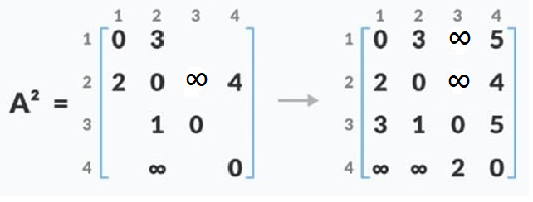
if the direct distance from the source to the destination is greater than the path through the vertex k, then the cell is filled with A[i][k] + A[k][j].
Similarly, A2 is created using A1.

Slide 40
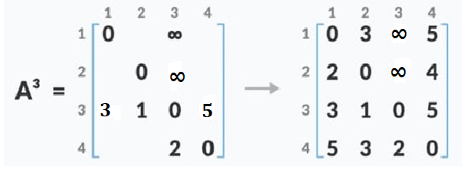
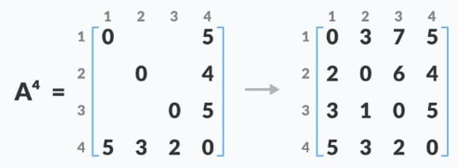

Slide 41

Formula for getting value from any intermediate vertex.
$A^{k}$[i, j] = min $\{ A^{k−1}$[i, j], $A^{k−1}$[i, k] + $A^{k−1}$[k, j]}
This kind of algorithm is better when graph is dense graph (Each vertex is connected with each other and also having negative weights).

Slide 42
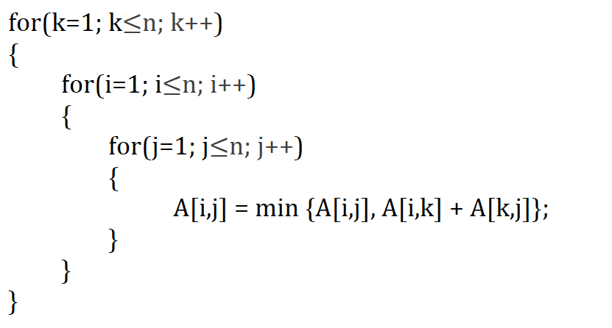
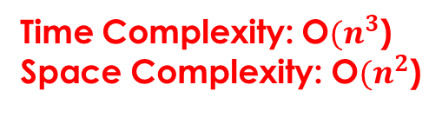
For intermediate vertex
To generate the matrix
Time Complexity: O${(n}^{3}$)
Space Complexity: O${(n}^{2}$)

Slide 43
Floyd Warshall Algorithm application:
To find the shortest path in a directed graph
To find a transitive closure of directed graphs: Basically for determining reachability of nodes.
Detecting negative-weight cycles in graphs. (If there is a negative weight cycle, the distance from a the start node to itself will be negative after running the algorithm)

Slide 44
Bellman Ford Algorithm
Floyd warshall algorithm can find the shortest path between all the pairs of vertices in a weighted graph but algorithm does not apply to graphs which containing negative weight cycle.
This can be done in the following way: Run the Floyd-Warshall algorithm for a given graph. Then a shortest path between vertices i and j does not exist if and only if there is a vertex t that is reachable from i and also from j for which d[t][t]<0.

Slide 45
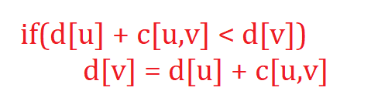
What is need of bellman ford algorithm?
Dijkstra's algorithm will not work for properly if the graph contains negative weight cycle. Some times dijkstra's may give and may not give the correct result and it is also not able to detect negative weight cycle which give an incorrect result and reduce the path length..
So, bellman ford algorithm can confirm that the result is correct which follows dynamic programming strategy.
As bellman ford algorithm follows dynamic programming, we have to try all the possibilities and we can do so by relaxing all the edges one by one.
Each edges of the graph are relaxed n-1 time. Where n=number of vertices.
Equation for Relaxing edges

Slide 46
First list out all the edges of the graph. You can select any edges first but make sure that each and every edges should be selected.
And relaxed each edge one by one.
Total how many time edges should be relaxed?
If the graph has total 7 vertices so relaxation can be done 6 (n-1)times.

Slide 47
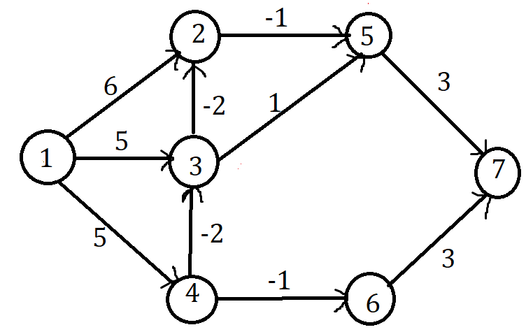
Example:
List out all edges: (1,2), (1,3), (1,4), (2,5), (3,2), (3,5), (4,3), (4,6), (5,7), (6,7)

Slide 48
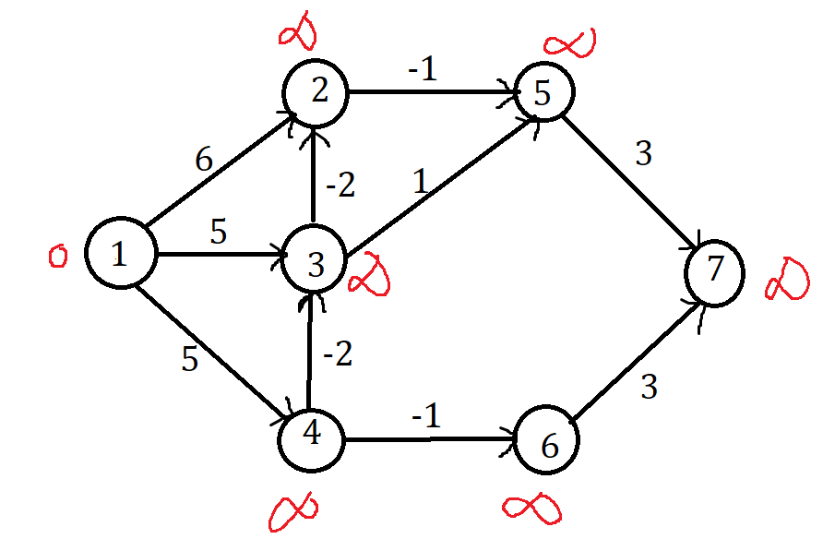
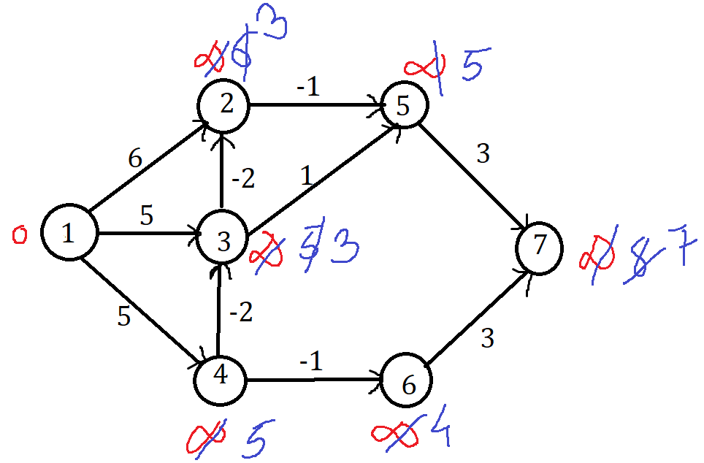
(1,2), (1,3), (1,4), (2,5), (3,2), (3,5), (4,3), (4,6), (5,7), (6,7)
Initialization
End of Pass One

Slide 49
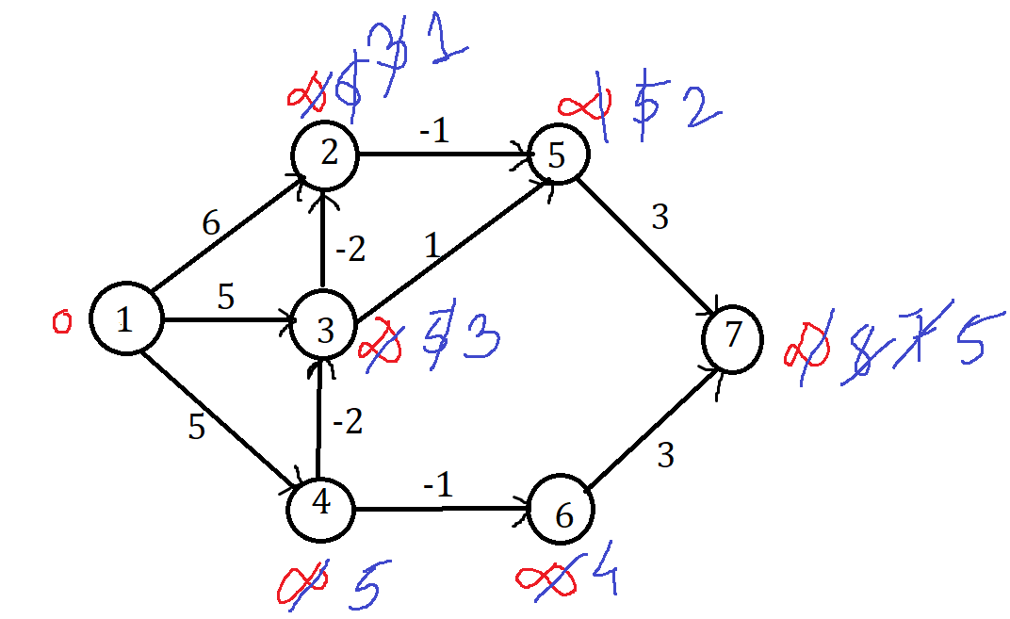
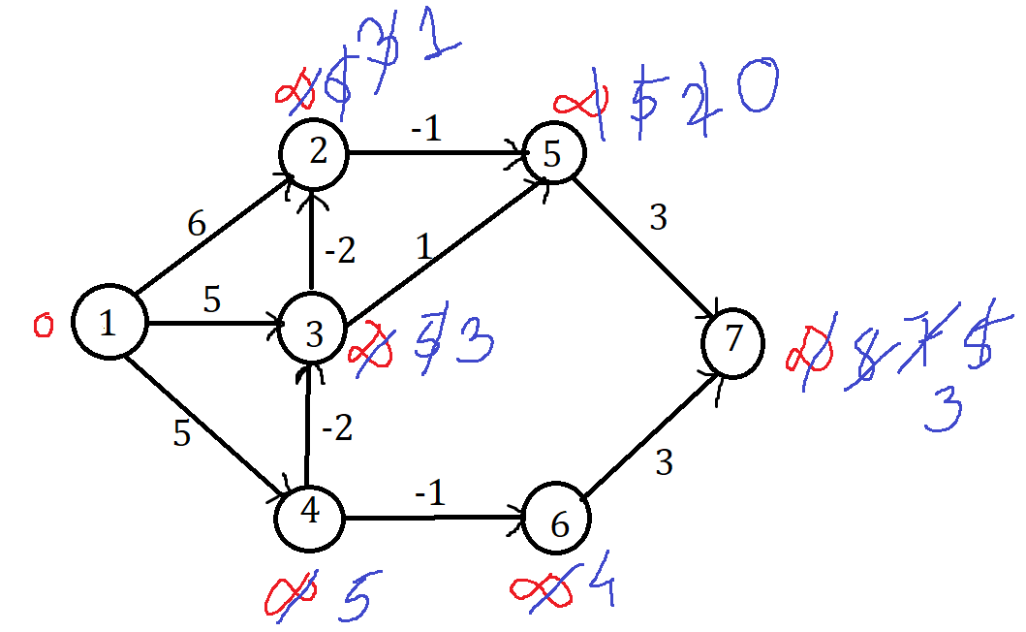
End of Pass Two
End of Pass Three

Slide 50
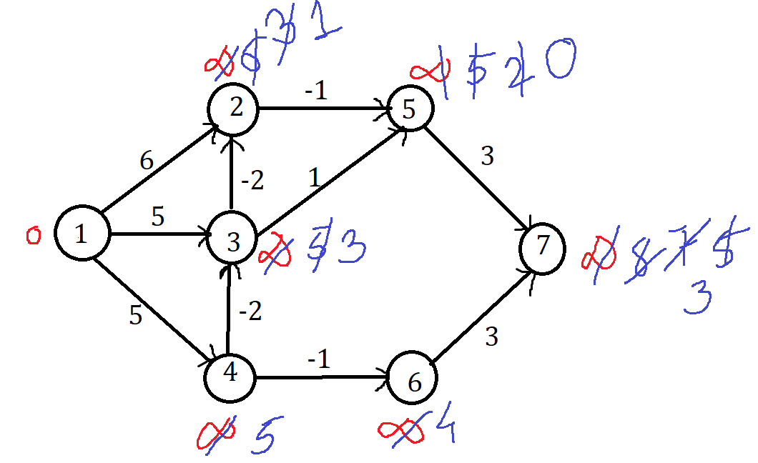
After pass four edge weights are not changed.
So, the shortest paths are
Vertex 1: 0, Vertex 2: 1, Vertex 3: 3, Vertex 4: 5, Vertex 5: 0, Vertex 6: 4, Vertex 7: 3.
End of Pass Four

Slide 51
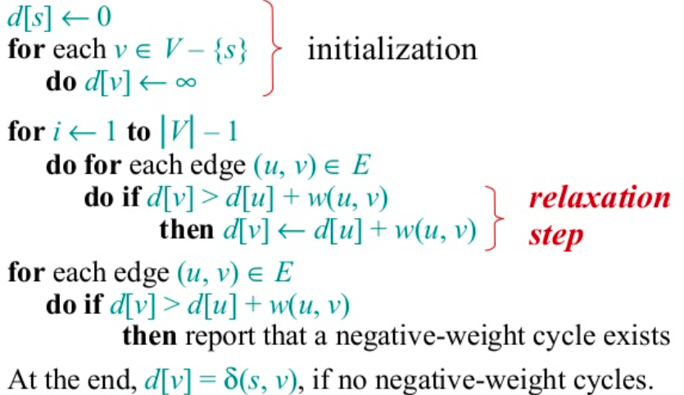
Algorithm:

Slide 52
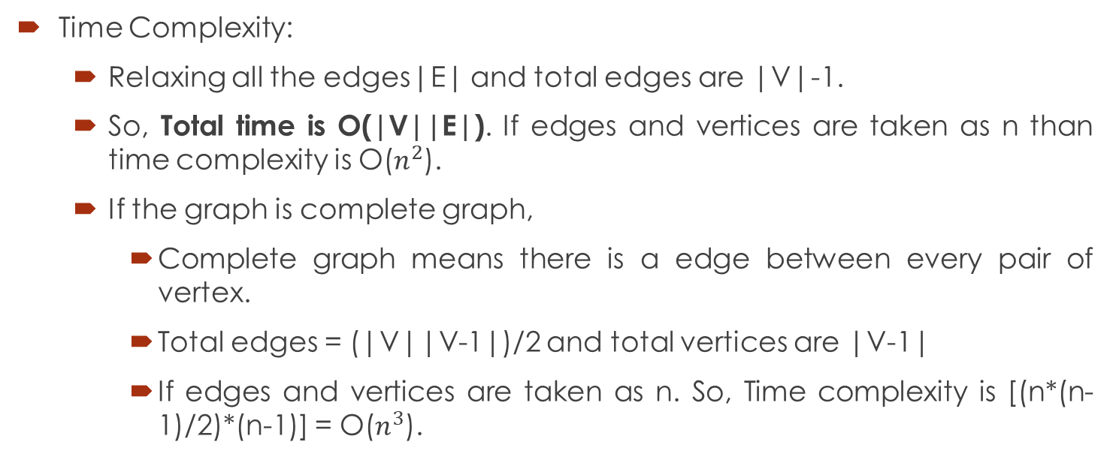
Time Complexity:
Relaxing all the edges|E| and total edges are |V|-1.
So, Total time is O(|V||E|). If edges and vertices are taken as n than time complexity is O($n^{2}$).
If the graph is complete graph,
Complete graph means there is a edge between every pair of vertex.
Total edges = (|V||V-1|)/2 and total vertices are |V-1|
If edges and vertices are taken as n. So, Time complexity is [(n*(n-1)/2)*(n-1)] = O($n^{3}$).

Slide 53
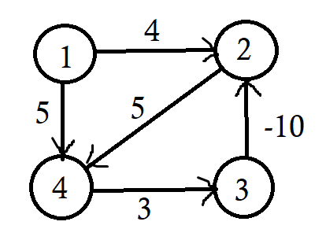
Disadvantage of Bellman-Ford Algo.
If a value d[v] fails to converge after |V|-1 passes, there exists a negative weight cycle in G reachable from S.
Example:
List out Edges: (1,2), (1,4), (2,4), (3,2), (4,3)
Total we have to relaxed edges 3 times.

Slide 54
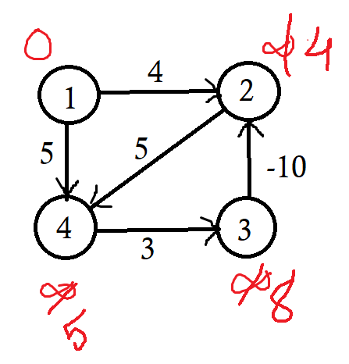
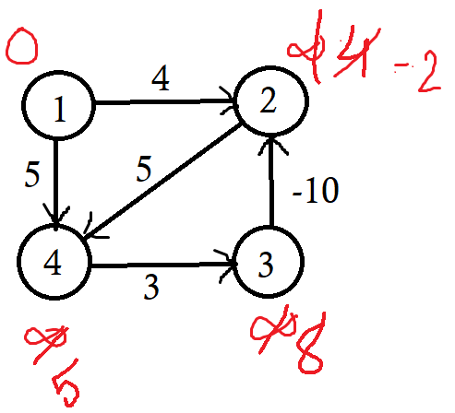
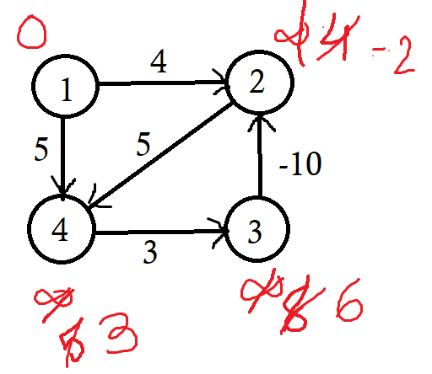
End of Pass One
End of Pass Two
End of Pass Three

Slide 55
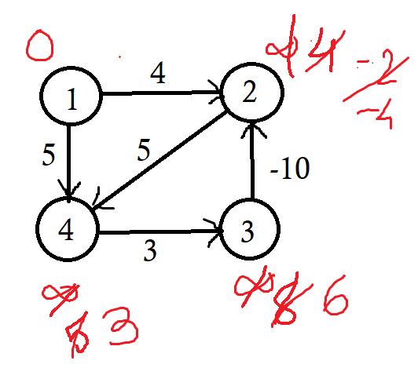
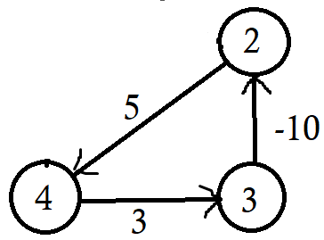
When we try to relax one more time than also it will relax.
Reason behind this id the graph contains a negative weight cycle.
Negative weight cycle = 5+3-10
= -2
End of Pass Four

Slide 56
Bellman ford algorithm failed when graph has negative weight cycle but it can detect if there is an negative weight cycle in the graph.
Bellman Ford's algorithm and Dijkstra's algorithm are very similar in structure. While Dijkstra looks only to the immediate neighbours of a vertex and Bellman goes through each edge in every iteration.
Application:
For calculating shortest paths in routing algorithms.

Slide 57
Matrix Chain Multiplication
Determine the optimal parenthesization of a product of n matrices.
We have already seen multiplication of only two matrices. However when more than two matrices are multiplied then the way in which the matrices are multiplied can change the cost of multiplication.
Matrix chain multiplication is an optimization problem that to find the most efficient way to given sequence of matrices. The Question is not to multiply and get the answer but which pair we should take such that the total cost of multiplying all of them is minimum.
So, matrix chain multiplication problem means how should we parenthesis them.

Slide 58
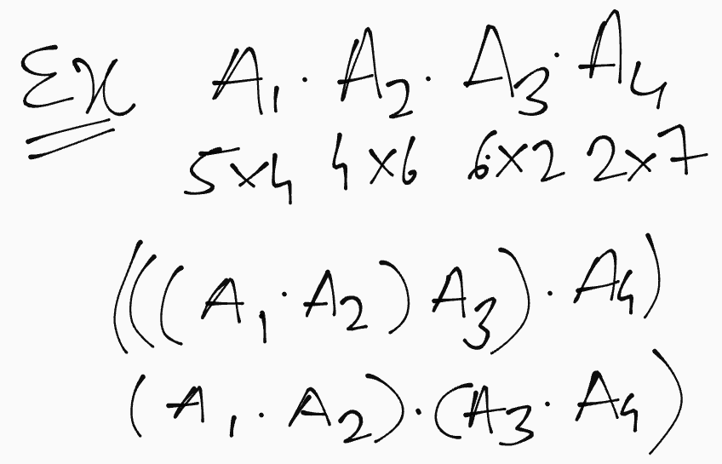
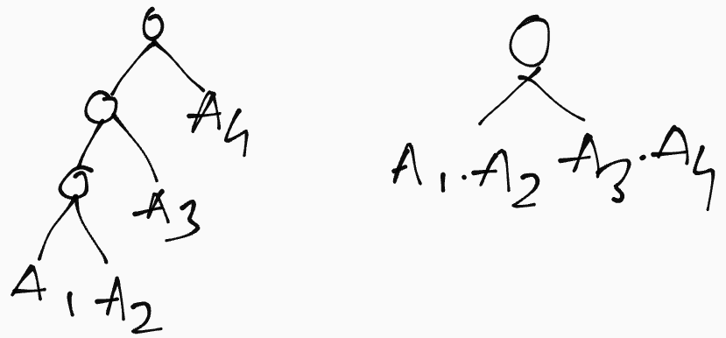
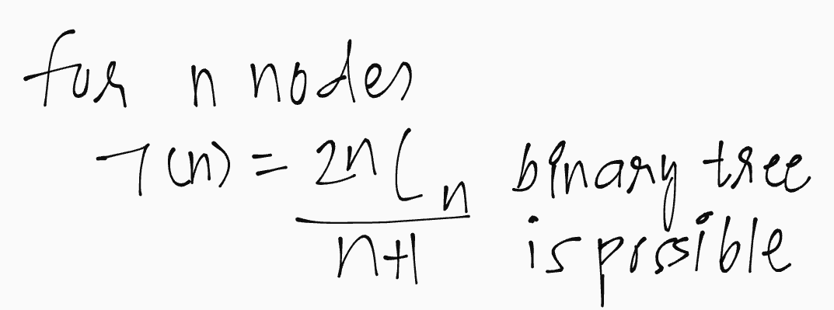
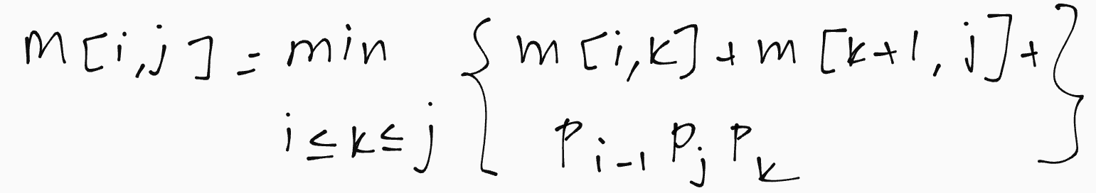
The formula used for matrix chain multiplication:

Slide 59
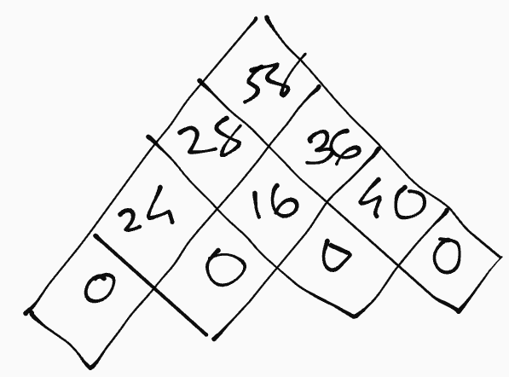
You can also draw the table like this
Example:
A1 = 3 Χ 2, A2 = 2 Χ 4, A3 = 4 Χ 2, A4 = 2 Χ 5
A1 A2 A3 A4
3 Χ 2 2 Χ 4 4 Χ 2 2 Χ 5
d0
d1
d2
d3
d4
M | 1 | 2 | 3 | 4
1 | 0 | 24 | 28 | 58
2 |  | 0 | 16 | 36
3 |  |  | 0 | 40
4 |  |  |  | 0
K | 1 | 2 | 3 | 4
1 | 0 | 1 | 1 | 3
2 |  | 0 | 2 | 3
3 |  |  | 0 | 3
4 |  |  |  | 0

Slide 60
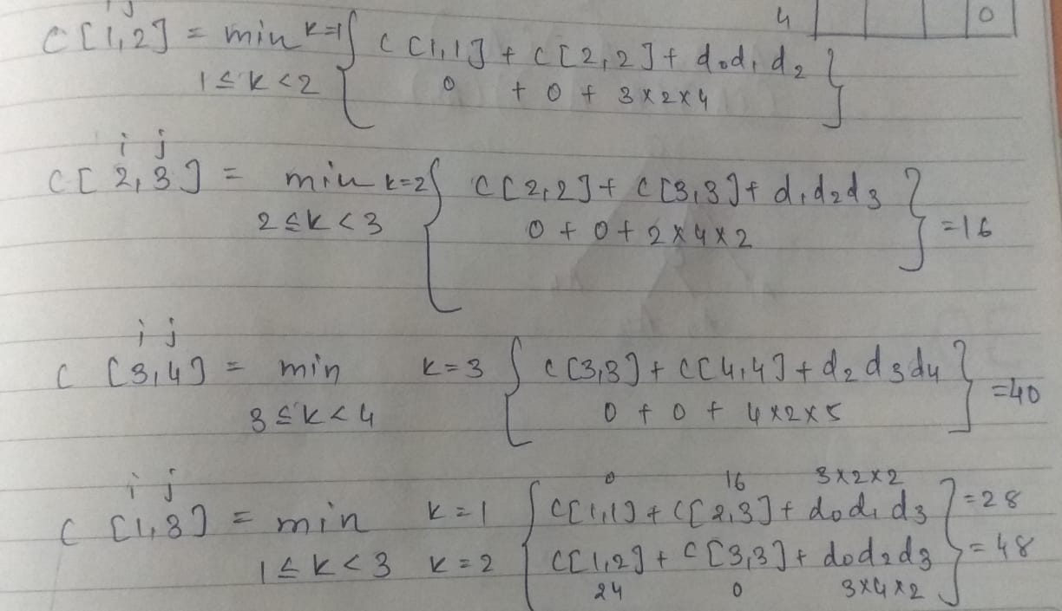

Slide 61
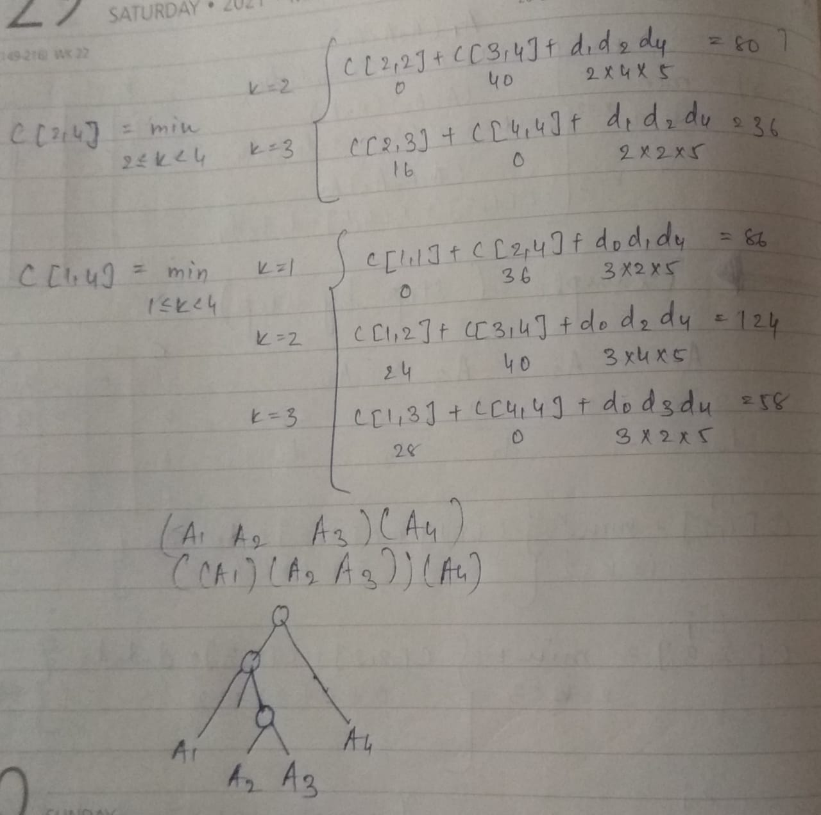

Slide 62
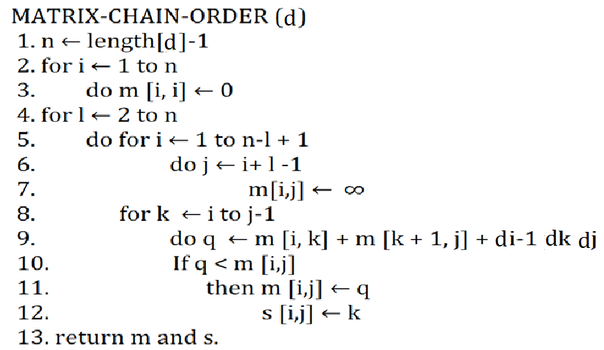
Algorithm:

Slide 63
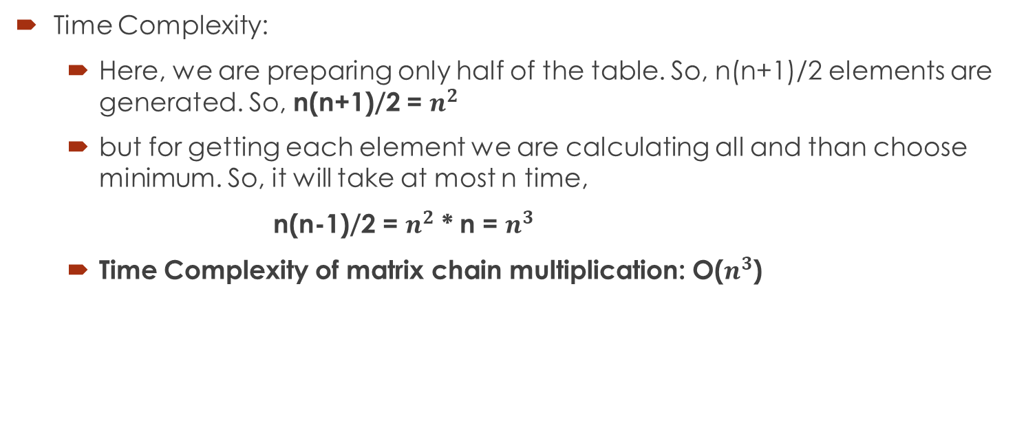
Time Complexity:
Here, we are preparing only half of the table. So, n(n+1)/2 elements are generated. So, n(n+1)/2 = $n^{2}$
but for getting each element we are calculating all and than choose minimum. So, it will take at most n time,
n(n-1)/2 = $n^{2}$ * n = $n^{3}$
Time Complexity of matrix chain multiplication: O($n^{3}$)

Slide 64
Longest Common Subsequence (LCS)
The longest common subsequence (LCS) is defined as the longest subsequence that is common to all the given sequences, provided that the elements of the subsequence are not required to occupy consecutive positions within the original sequences.
If S1 and S2 are the two given sequences then Z is the common subsequence of S1 and S2 if Z is a subsequence of both S1 and S2. Furthermore, Z must be a strictly increasing sequence of the indices of both S1 and S2.
In a strictly increasing sequence, the indices of the elements chosen from the original sequences must be in ascending order in Z.

Slide 65
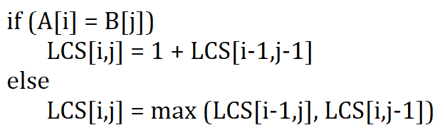
Example:
S1 = {B, C, D, A, A, C, D}, S2 = {A, C, D, B, A, C}
Then, common subsequences are
{B, C}, {C, D, A, C}, {D, A, C}, {A, A, C}, {A, C}, {C, D}, ...
Among these subsequences, {C, D, A, C} is the longest common subsequence.
Equations used for LCS:
If matched
If no matched

Slide 66
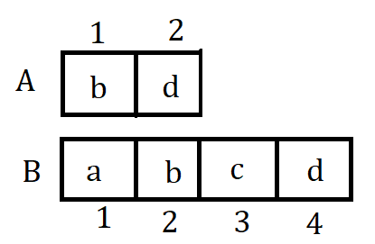
Find longest common subsequence using dynamic programming.
LCS = bd
 |  |  | a | b | c | d
 |  | 0 | 1 | 2 | 3 | 4
 | 0 | 0 | 0 | 0 | 0 | 0
b | 1 | 0 | 0 | 1 | 1 | 1
d | 2 | 0 | 0 | 1 | 1 | 2
 |  |  | a | b | c | d
 |  | 0 | 1 | 2 | 3 | 4
 | 0 | 0 | 0 | 0 | 0 | 0
b | 1 | 0 | 0 | 1 | 1 | 1
d | 2 | 0 | 0 | 1 | 1 | 2
2
Maximum Length of subsequence
b
d

Slide 67

Algorithm:

Slide 68


Time Complexity:
Total no. of cells are Θ(m * n)
So, time complexity is Θ(m * n)
m no. of alphabets
n no. of alphabets

Slide 69
Applications of Longest Common Subsequence:
In compressing genome resequencing data
To authenticate users within their mobile phone through in-air signatures

Slide 70

Assembly Line Scheduling

Slide 71

Manufacturing problem to find the fastest way through a factory.
Pair of assembly lines, each with n stations
parameters:
Si,j: The $j^{th}$ station on assembly line i
ai,j: Assembly time at the $j^{th}$ station on line i
ei: Time to enter assembly line 1
xi: Time to exit from assembly line 1
ti,j: Time to transfer away from station Si,j to station Sx,j+1 on other line
if i=1, x=2 and if i=2, x=1

Slide 72

Assembly line programming is an example of dynamic programming solves a manufacturing problem.
Example: The Motor Corporation produces automobiles in a factory that has two assembly lines, shown in below figure.

Slide 73
Problem Statement:
Determine which stations to chose from line 1 and which to choose from line 2 in order to minimize assembly time.
First consider the optimal way for a product to get from the starting point through station S1,j
If j=1, there is one choice
go through station 1,1
For j=2, 3, 4, ..., n there are two choices
if the fastest way through S1,j-1 then
stay on line 1 through S1,j
if the fastest way through S2,j-1 then
transfer from line 2 to line 1 and then through station S1,j

Slide 74
Recursive Solution
Assembly line 1
for station 1
F1[1] = e1 + a1,1
for station 2, 3, ...., n, we have
F1[j] = min { (F1[j-1] + a1,j), (F2[j-1] + t2,j-1 + a1,j)}
Top down approach, recalculation

Slide 75
Optimal substructure property
to find the fastest way through station j, we solve the sub problems of finding the fastest way through station j-1
Let Fi[j] - fastest time to get a product from the starting point through station Si,j
The goal is to compute the fastest way through the factory F*
F* = min{F1[n] + x1, F2[n] + x2}
Time to get through station 1
Fi[1] = ei + ai,1, for both i=1 and i=2

Slide 76

Problem:
What stations should be chosen from line 1 and which from line 2 in order to minimize the total time through the factory from one car?

Slide 77

1 | 2 | 3 | 4 | 5
9 | 18[1] | 20[2] | 24[1] | 32[1]
12 | 16[1] | 22[2] | 25[1] | 30[2]
F* = 35
F1[j]
l* = 1
F2[j]

Slide 78
Algorithm
f1[1] <- e1 + a1,1
f2[1] <- e2 + a2,1
for j <- 2 to n
do if f1[j-1] + a1,j <= f2[j-1] + t2,j-1 + a1,j
then f1[j] <- f1[j-1] + a1,j
l1[j] <- 1
else f1[j] <- f2[j-1] + t2,j-1 + a1,j
l1[j] <- 2
if f2[j-1] + a2,j <= f1[j-1] + t1,j-1 + a2,j
then f2[j] <- f2[j-1] + a2,j
l2[j] <- 2
else f2[j] <- f1[j-1] + t1,j-1 + a2,j
l2[j] <- 1
Compute Initial values of f1 and f2
Compute the values of f1[j] and l1[j]
Compute the values of f2[j] and l2[j]

Slide 79
if f1[n] + x1 <= f2[n] + x2
then f* = f1[n] + x1
l* = 1
else f* = f2[n] + x2
l* = 2
Where,
a[i,j] = assembly time on jth station on ith line
t[i,j] = transit time from jth station on ith line to j+1th station on another line
e[i] = entry time on line i
x[i] = exit time on line i
n = no of station on every line
Compute the values of the fastest time through the entire factory
Time Complexity = Ɵ(n)

Slide 80


F* = 28
l* = 1

Slide 81


Travelling Salesman Problem
Given a set of cities and distance between every pair of cities, the problem is to find the shortest possible route that visits every city exactly once and returns to the starting point.
This algorithm can be solve by brute force method, dynamic programming and branch and bound method.
Brute force method: Find out all possible path and select minimum path.
Example:

Slide 82


Using Greedy Method
Using Brute-Force Method
Optimal Solution
Time Complexity of Brute-Force Method = n! ($n^{n}$)

Slide 83


Example:

Slide 84

Travelling Salesman Problem Using Dynamic Programming

Slide 85



General Formula used to solve this problem:
Calculation steps:
∈
=> min[16+22=38, 11+28=39, 6+17=23]
=> min[13+14=27, 16+6=22]


=> 9+5=14
=> 2+4=6
=> min[7+21=28, 9+20=29]
=> 16+5=21
=> 12+8=20

Slide 86


The Path is
A -> D -> C -> B -> A with Cost 23.
The Time Complexity is $2^{n}$ (Exponential) which is better than Brute-Force method.
=> min[12+17=29,2+15=17]

=> 13+4=17

=> 7+8=15

